Slide 1
Customer Churn Prediction
Telecom Industry

Slide 2
Introduction - Customer Churn
What is Customer Churn?
Customer churn is the percentage of customers that stopped using the company’s product or service during a certain time frame.
Why does it matter?
Customer churn is an important KPI which directly impacts the profitability of the company. A small churn rate can compound quickly leading the business to struggle to plug in lost revenue and remain profitable.
How does knowing beforehand which customer is likely to churn help us?
The ability to predict that a particular customer is at a high risk of churning, while there is still time to do something about it, represents a huge additional potential revenue source for companies.
It is generally thought to cost five times more to gain a new customer than it costs to keep an existing customer.
The primary objective of the customer churn predictive model is to retain customers at the highest risk of churn by proactively engaging with them.
Notes:
(1-.05)^12

Slide 3
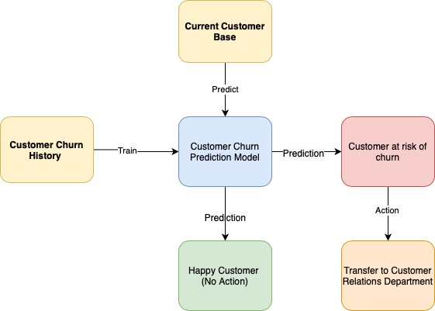
Customer Churn Model Flow

Slide 4
Customer Churn History Data
Telecom Customer Churn Dataset - 7043 customers in California, US in Q3
Primary Dataset - Telecom customer churn
The churn column indicates whether or not the customer left within the last month. Other columns include gender, dependents, monthly charges, and many with information about the types of services each customer has.
This dataset is utilized to train the prediction model
Secondary Dataset - Telecom customer churn status and reason for leaving
Contains information about whether or not a particular customer has left the fictional telco company, and their reason for leaving.
The dataset is utilized more as an ancillary dataset to analysis why do customers tend to churn
Structured data format - Excel files

Slide 5
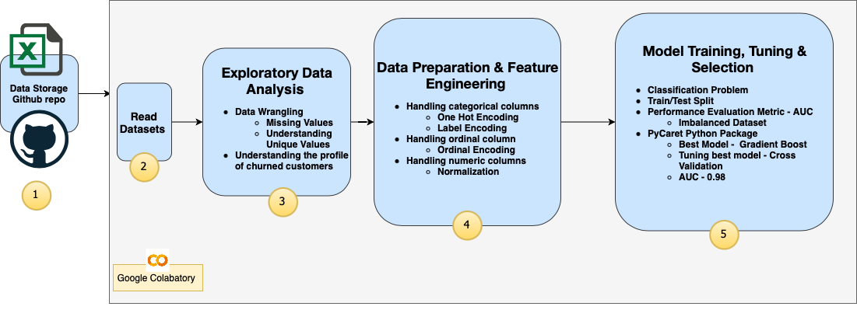
Process Flow

Slide 6
Step 1 & 2
Data Storage
Git Repository
Data Read
Python Native package - Pandas

Slide 7
Step 3 - Exploratory Data Analysis
Step 3.1 - Data Wrangling
Null Value Analysis
'Total Charges' column has 11 null values. Nominal relative to the dataset size. These are specific to customers who are new i.e. ‘Tenure months’ is 0. Therefore, we can input 0 inplace of null values.
'Churn Reason' column has 5174 null values which accounts for ~73% of data. These are expected nulls for customers who did not churn.
Unique Value Analysis
Columns - ‘Quarter’,'Count', 'Country', 'State' have single values. Therefore don’t provide any reasonable insight to customer churn profile and therefore are removed from analysis.
‘CustomerID’ is unique for each row and doesn’t provide any information gain for analysis. It is required only to reconcile the primary and secondary dataset.

Slide 8
Step 3 - Exploratory Data Analysis
Step 3.2 - Understanding churned customer profile
Bucketing attributes into different categories and analysing their impact
Attribute buckets
Monthly Charges
Lifespan Analysis
Customer Demographic Attributes
Customer Contract Attributes
Service related Attributes
What makes customers churn

Slide 9
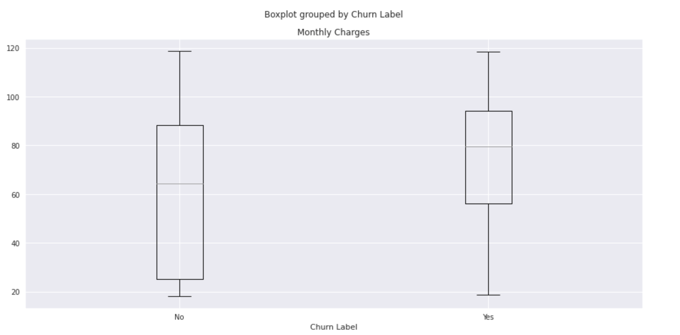
Q1. How does monthly charges affect likelihood of a customer churning?
No surprises here - Customers who churned were paying more in average monthly charges (80 dollars) relative to customers who did not churn (~63 dollars)

Slide 10
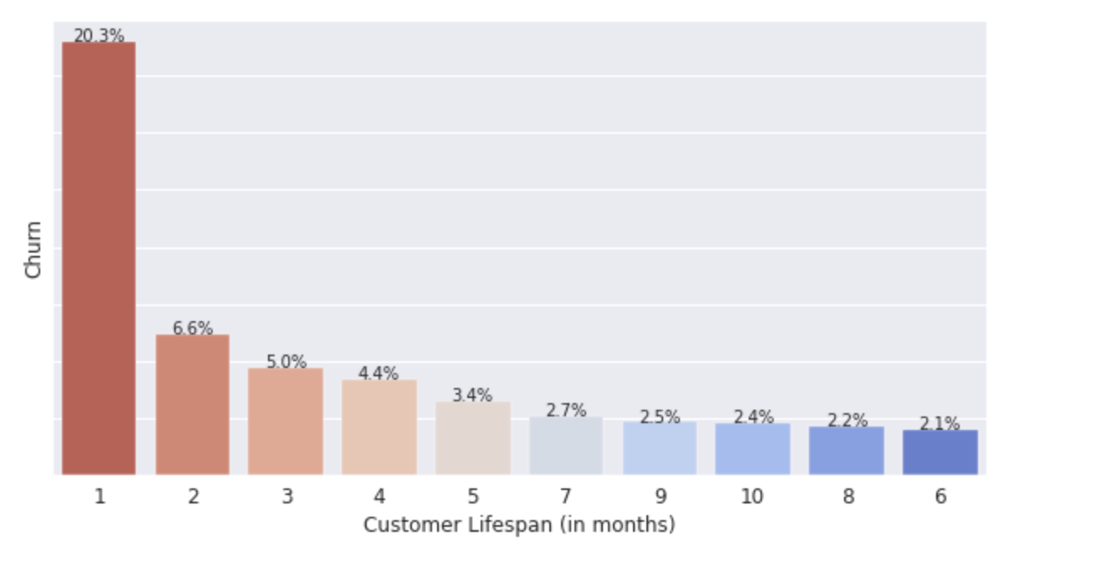
Q2- When are customers likely to churn in their lifespan?
The majority of churn rate is observed on the subscription first month, totalling 20.3% of subscribers leave on the first month. Most of the subscribers leave on the first 3 months, totalling 31.9% of the total churn.

Slide 11
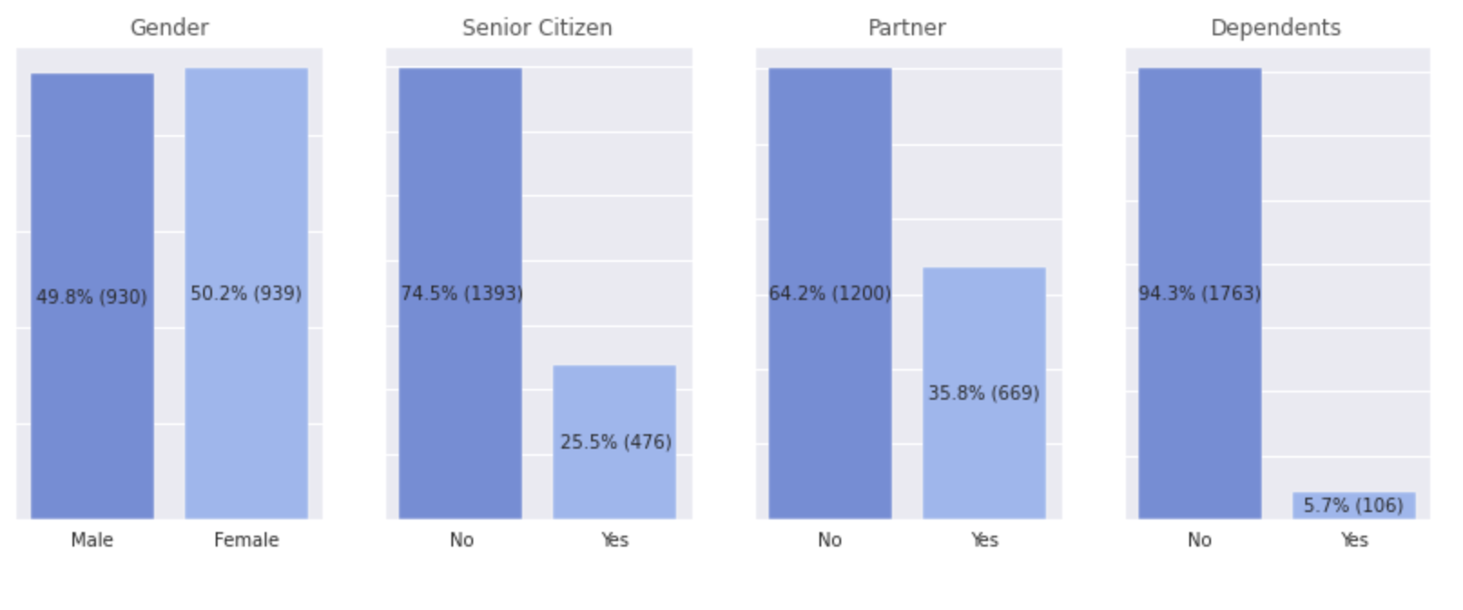
Q3- Looking at customer personal attributes to analyze what makes them churn

Slide 12
Q3- Looking at customer personal attributes to analyze what makes them churn
Gender - Does customer's gender play a role in determining if they are likely to churn or not? Gender does not seem to play a crucial role in determining if a customer is going to churn. The historically churned customers are almost equally likely to be a female or male.
Senior Citizen - Does customer's being a senior citizen or not play a role in determining if they are likely to churn or not? Senior citizens comprise of one fourth of the churned customers making them 3 times less likely to churn compared to non senior citizen customers.
Partner - Does customer's being married or not play a role in determining if they are likely to churn or not? Customers who have partners comprise of one third of churned customers making them twice as less likely to churn than customers who do not have partners.
Dependents - Does customer's having dependents or not play a role in determining if they are likely to churn or not? Customers who have dependents comprise of 5% of total churned customers making them very unlikely to churn.

Slide 13
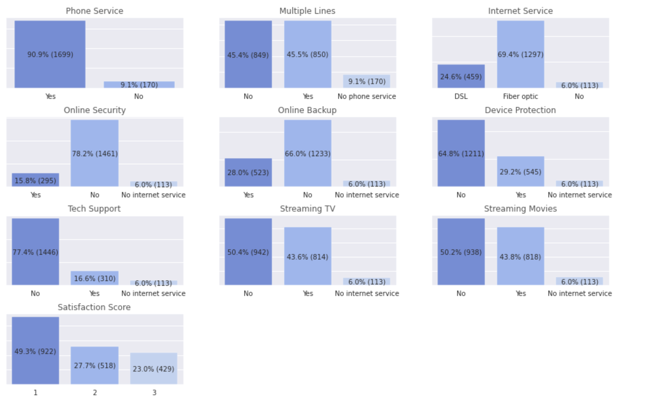
Q4 - Looking at service related attributes to analyze that may attribute to a customer churning
Notes:
Extra services enabled churn more

Slide 14
Q4 - Looking at service related attributes to analyze that may attribute to a customer churning
Phone Service - Does customer's having phone service enabled play a role in determining if they are likely to churn or not? The large majority of churned customers(~91%) had Phone Service enabled. This gives an avenue to drill deeper into understanding what are the issues pertaining Phone Service.
Multiple Lines - Does customer's having multiple phone lines enabled play a role in determining if they are likely to churn or not? Whether customer has a multiple phone lines or not does not play a crucial role in determining if a customer is going to churn. Both customer bases are equally likely to churn.
Internet Service - Does type of Internet Service a customer is using play a role in determining if they are likely to churn or not? Customers that have Fiber-Optic Internet Service (~ 70%) are more likely to cancel than those who have DSL(~25%)
Online Security - Does customer having online security enabled play a role in determining if they are likely to churn or not? The customers who do not have online security enabled are more likely to churn. Majority of churned customers (~78%) do not have online security enabled.

Slide 15
Q4 - Looking at service related attributes to analyze that may attribute to a customer churning
Online Backup - Does customer having online backup enabled play a role in determining if they are likely to churn or not? The customers who do not have online backup enabled are more likely to churn. Majority of churned customers (~66%) do not have online backup enabled.
Device Protection - Does customer having device protection enabled play a role in determining if they are likely to churn or not? The customers who have device protection enabled are less likely to churn. Majority of churned customers (~65%) do not have device protection enabled.
Tech Support - Does customer subscribing to an additional technical support plan play a role in determining if they are likely to churn or not? The customers who tend to subscribe to tech support are less likely to churn. Majority of churned customers (~77%) do not have tech support enabled.
Streaming TV - Does customer using the Internet service to stream television programing from a third party provider play a role in determining if they are likely to churn or not? The customers who stream TV or movie are similarily likely to churn as the customers who don't stream TV or movie.

Slide 16
Q4 - Looking at service related attributes to analyze that may attribute to a customer churning
Streaming Movies - Does customer use the Internet service to stream movies from a third party provider play a role in determining if they are likely to churn or not? The customers who stream TV or movie are similarly likely to churn as the customers who don't stream TV or movie.
Satisfaction Score - Does customer having online security enabled play a role in determining if they are likely to churn or not? Would conducting regular satisfaction surveys help in determining which customers would likely churn? No surprise here. Customers with high satisfaction score (4 & 5) do not churn at all. Customers with lowest satisfaction score (1) comprise half of the customers churned while customers with lower satisfaction score (2 & 3) comprise of other half of the churned customers. Conducting customer satisfaction surveys to determine if the customers is satisfied or not would help determine early if a customer is likely to churn.

Slide 17
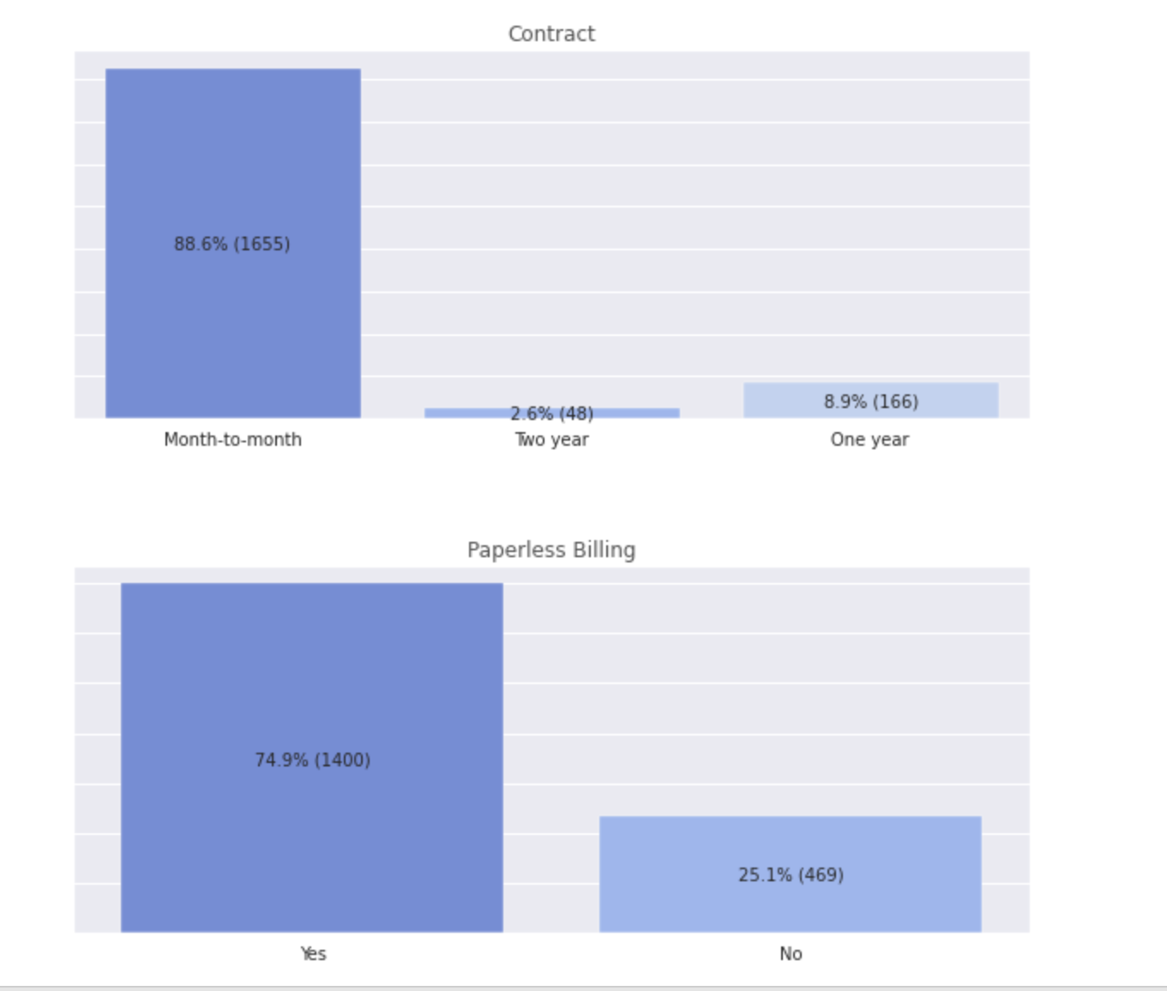
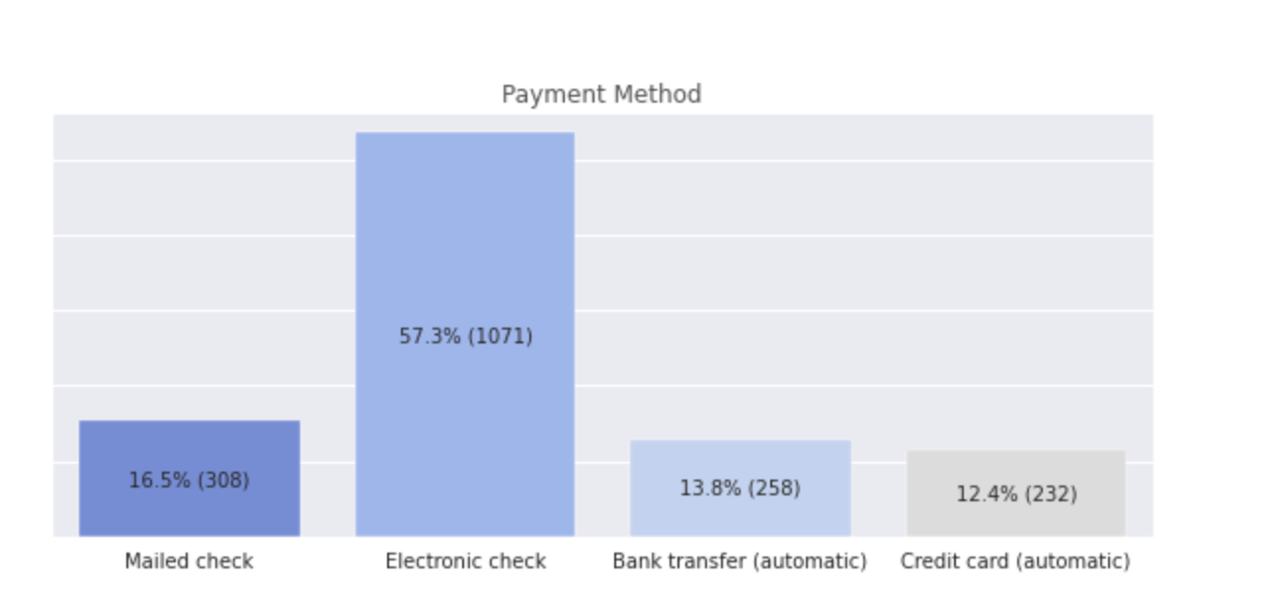
Q5 - Looking at customer's contract attributes to analyze what makes them churn

Slide 18
Q5 - Looking at customer's contract attributes to analyze what makes them churn
Contract - Does customer's contact type a role in determining if they are likely to churn or not? Longer the contact less likely is the customer to churn. Month to month make up ~89% of the historically churned customers.
Paperless Billing - Does customer's having paperless billing enabled or not play a role in determining if they are likely to churn or not? Customers who do not have paperless billing enabled comprise of one fourth of the churned customers making them 3 times less likely to churn compared to customers who have paperless billing enabled.
Payment Method - Does customer's type of payment method play a role in determining if they are likely to churn or not? Customers who have Electronic check enabled as payment method comprise of half of churned customers. Therefore making such customers more likely to churn compared to customers having other payment method.

Slide 19
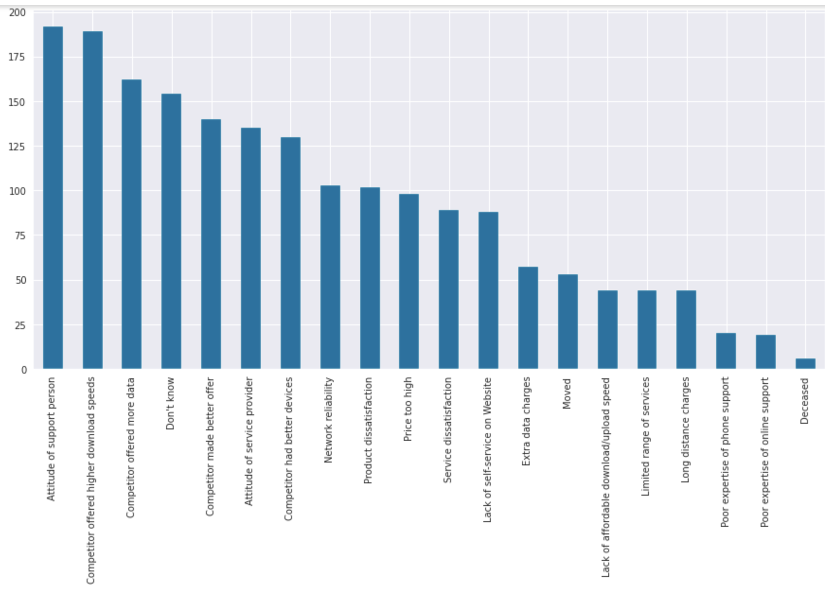
Q5 - Why do customers churn

Slide 20
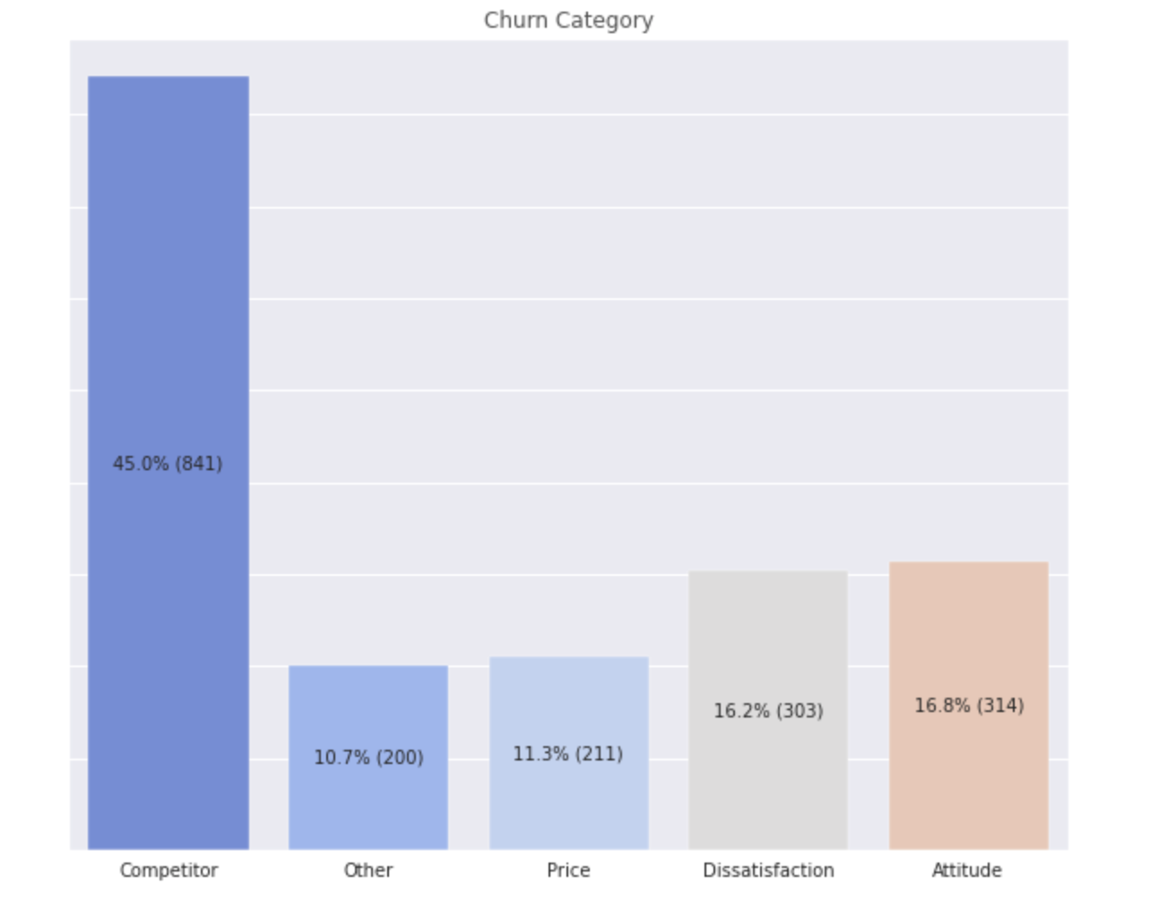
Q5 - Why do customers churn

Slide 21
Q5 - Why do customers churn
Customers that churn turn away from the service due to:
Move to a competitor because they offer a better deal relating to plan, data, download speeds etc
Customer support experience provided was unsatisfactory. Primarily due to the attitude of the support person or service provider.
Service features are unsatisfactory. Different features of the services provided like network reliability, limited range of services, lack of affordable data upload/download etc left the customers dissatisfied.

Slide 22
Step 4 - Feature Engineering
Categorical columns -
Number of categories < 10 - One Hot Encoding
Columns - 'Gender', 'Senior Citizen', 'Partner', 'Dependents', 'Phone Service', 'Multiple Lines', 'Internet Service', 'Online Security', 'Online Backup', 'Device Protection', 'Tech Support', 'Streaming TV', 'Streaming Movies', 'Contract', 'Paperless Billing', 'Payment Method'
One hot encoding converts each label within a category into a binary column. These techniques increases the number of columns within the dataset such that it creates 'n-1' new columns for each category containing 'n' labels. This leads to sparser data and thus is not recommended for categorical data containing high # of labels.
Number of categories > 10 - Label Encoding
'City' and 'Zip Code' are encoded using label encoding. One hot encoding is not utilised as the number of columns created with very large having binary values and would have made the data incredibly sparse. Instead Label Encoding converts the labels within each category into a numeric form so as to convert them into the machine-readable form.
Number if categories == Number of rows - Removed from the final dataset 'Customer ID' is removed before further analysis
Ordinal column - Ordinal Encoding
Column - 'Satisfaction Score' Each unique category value is assigned an integer value such that they have their innate order maintained.
Numeric Column - Scale/ Normalize
Columns : 'Monthly Charge', 'Total Charge', 'CLTV', 'Latitude', 'Longitude', 'Tenure Months'. These columns are normalize such that they have zero mean and constant mean. Normalization is done to make sure the features are scaled to a common scale, without distorting differences in the ranges of values.

Slide 23
Step 5 - Model Train, Tuning & Selection
Classification Problem
Train/Test Split
Performance Evaluation Metric - AUC
Imbalanced Dataset
PyCaret Python Package
Best Model - Gradient Boosting
Tuning best model - Cross Validation
AUC value - 0.98
Understanding Feature Importance (Top 5)

Slide 24
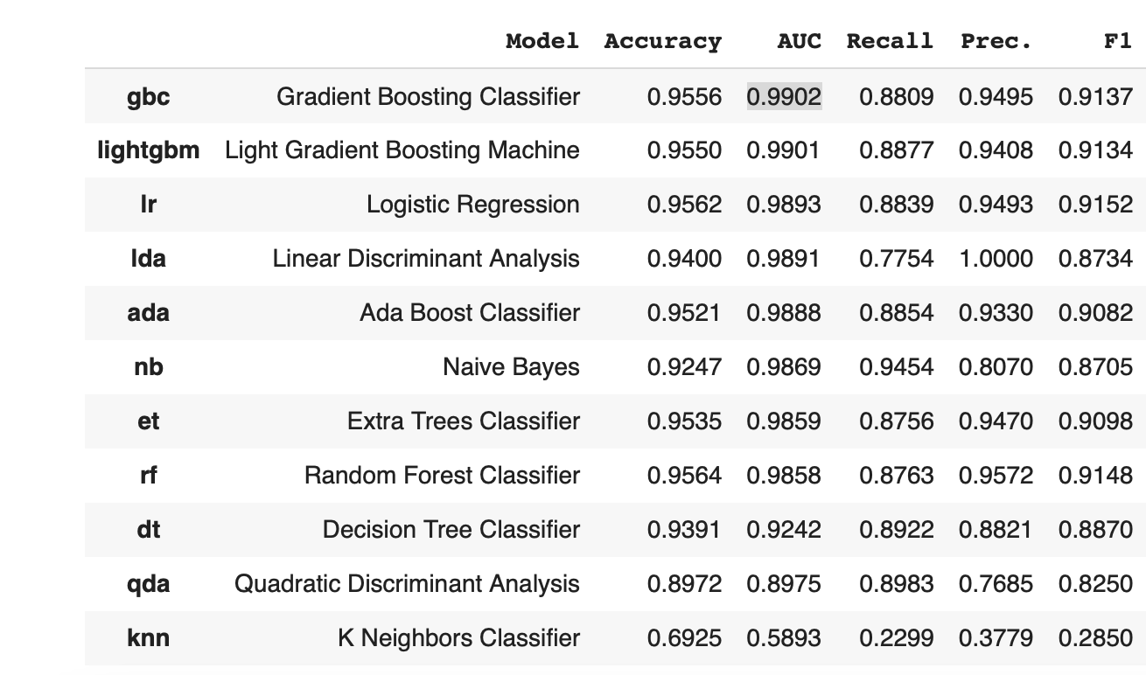
Best Model based on Evaluation Metric
Metric Utilized - AUC

Slide 25
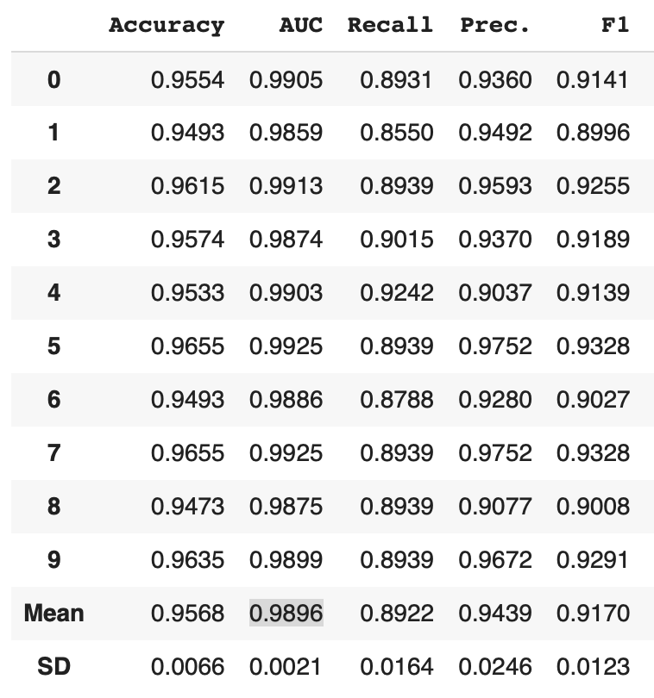
Best Model Tuning

Slide 26
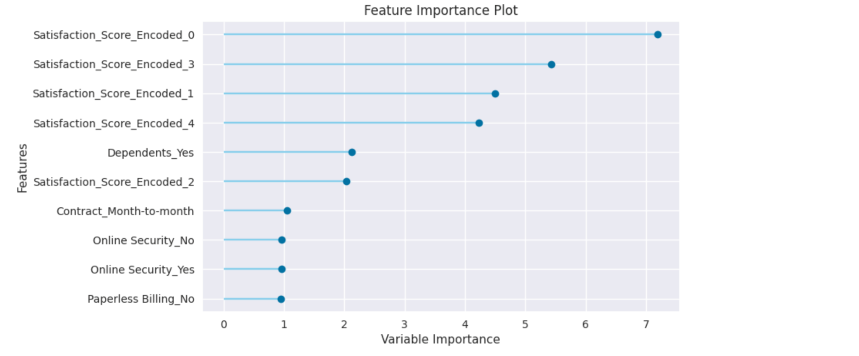
Feature Importance

Slide 27
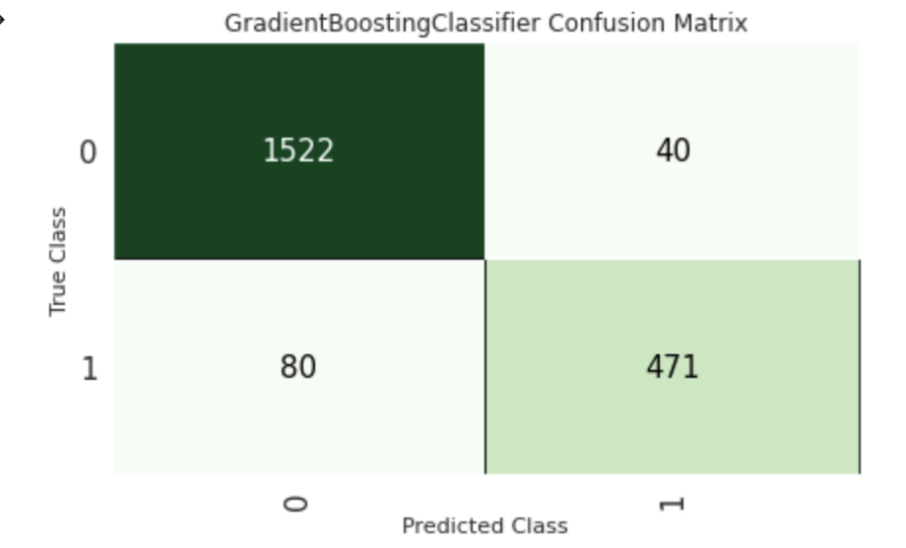
Understanding Business Impact
Let’s say, if each churned customer leads to loss $1000 in revenue. Before the model, all churned customers would be lost revenue - $1000* 551 = $551, 000
As a retention action, we provide $100 incentive to customers who are predicted to be churned. That is all the customers the model labels as positive.
Model labels 511(40 + 471) as positive. So, we spend $100 * 511 = $51100. Out of which we spend 40 * $100 = $4000 on customers who would not have churned i.e., these customers are false positives.
However, we correctly predicted 471 customers. And saved $(471*1000) - $51100 = $419,900. We did not predict 80 churned customers and would lose $(80*1000) in revenue.
Total revenue saved = $(419,900 - 80,000) = $339,900

